Slide 1

Python as an Additional Language
Lesson 2: Program code vs data

Slide 2
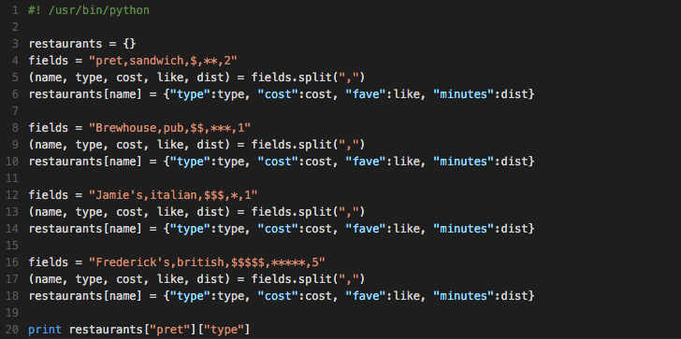

Revisiting last week
Things got a bit repetitive:

Slide 3
What now?
How can we improve?

Slide 4
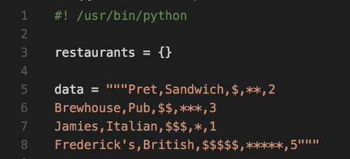
Let’s put all the data in one place
Triple-quotes denote a literal string.

Slide 5
for! What is it good for?

Slide 6
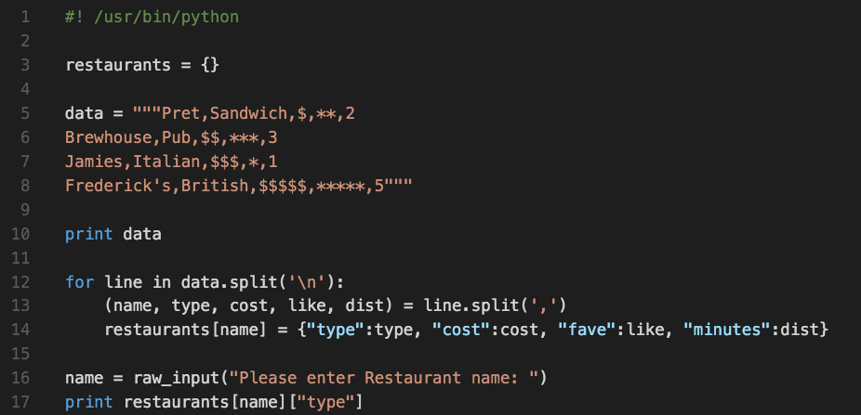
Putting it back together

Slide 7
Where should we keep the data?

Slide 8
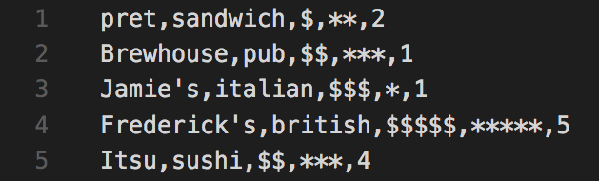
Where should we keep the data?
Only the feeble-minded mix code and configuration!
Create a separate file: restaurants.csv

Slide 9
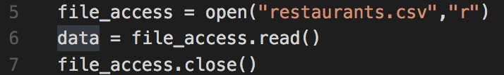
How to access an external file
readline() might also be useful too…

Slide 10
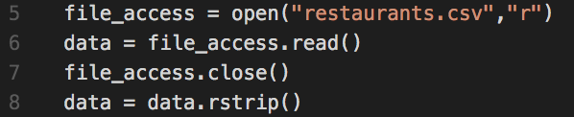
What happened?
Why did (some of) you get an error?
Let’s fix that up:

Slide 11
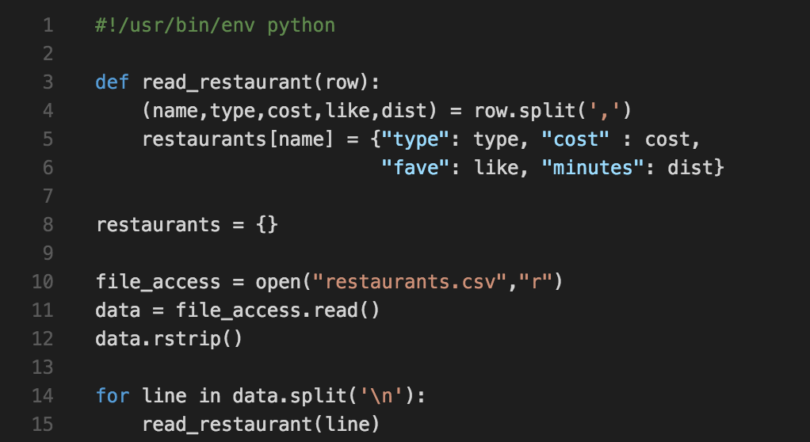
Functions: Abstracting things away

Slide 12
Garbage in, Garbage out…
What type of data is in the CSV file?
What type of interaction might we want with it?
Let’s make some changes!

Slide 13
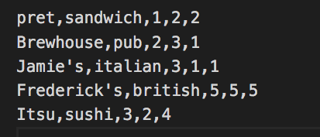
New sample data file

Slide 14

How do we search for an attribute?
I only want to walk at most 3 minutes from the office to get lunch.
What does this do?
What data type is returned by restaurants.keys()?

Slide 15
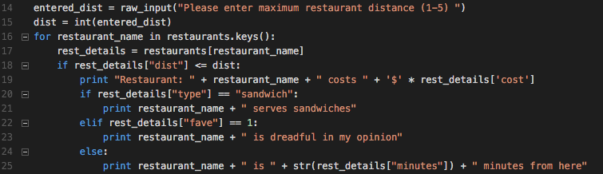
How do we search for an attribute?
Why doesn’t this code work as I’ve written it?
What is the purpose of rest_details?

Slide 16
Next week…
Getting someone else to do the hard work
Crazy loops
Questions? Comments? Come see us in S32, on Friday, 11:00-12:00

